Slide 1
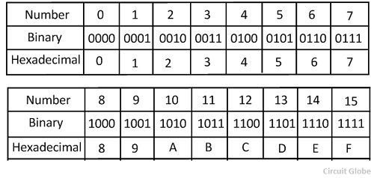
Hexadecimal
Base 16 number system:

Slide 2
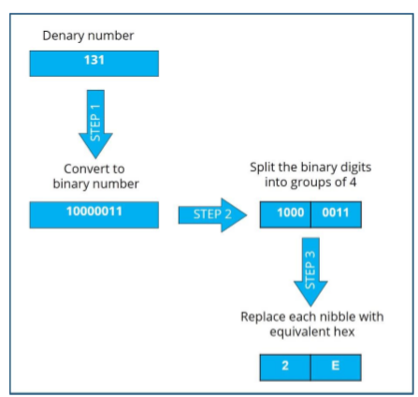
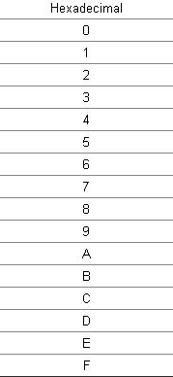
Dec - Hex

Slide 3
Dec - Hex

Slide 4
Dec - Hex

Slide 5
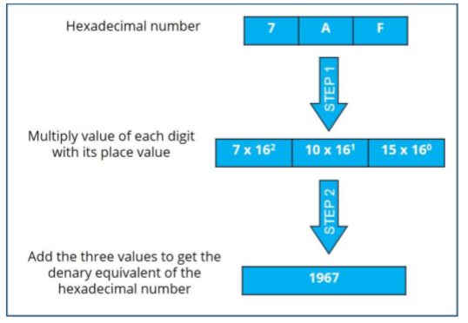
Hex – Dec

Slide 6
Hex - Dec

Slide 7
Hex - Dec

Slide 8
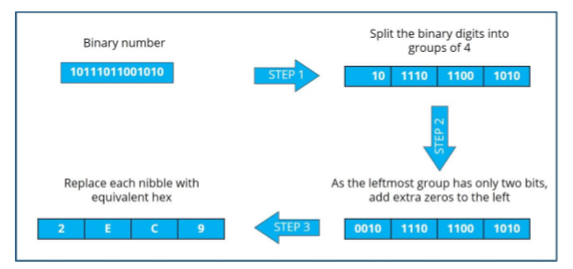
Bin - Hex

Slide 9
Bin - Hex

Slide 10
Bin - Hex

Slide 11
Bin - Hex

Slide 12
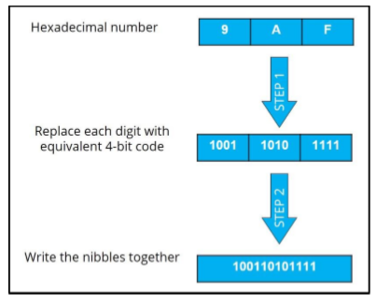
Hex - Bin

Slide 13
Hex - Bin

Slide 14
Hex - Bin

